Slide 1


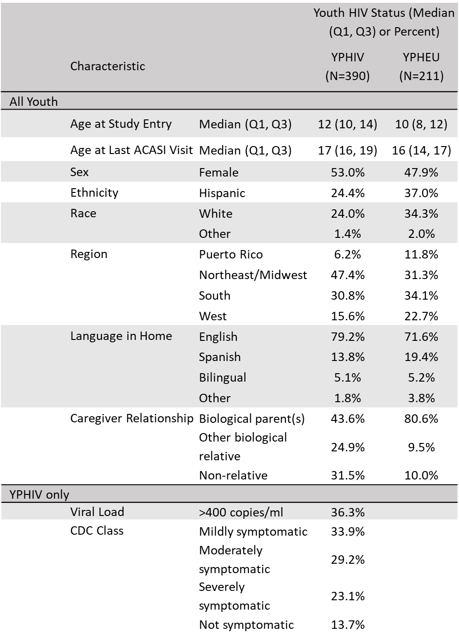
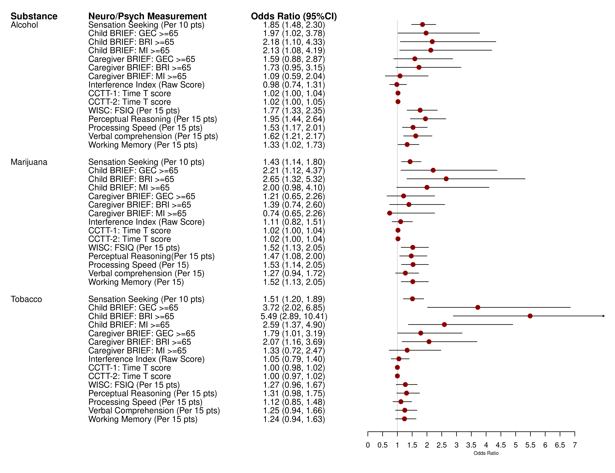

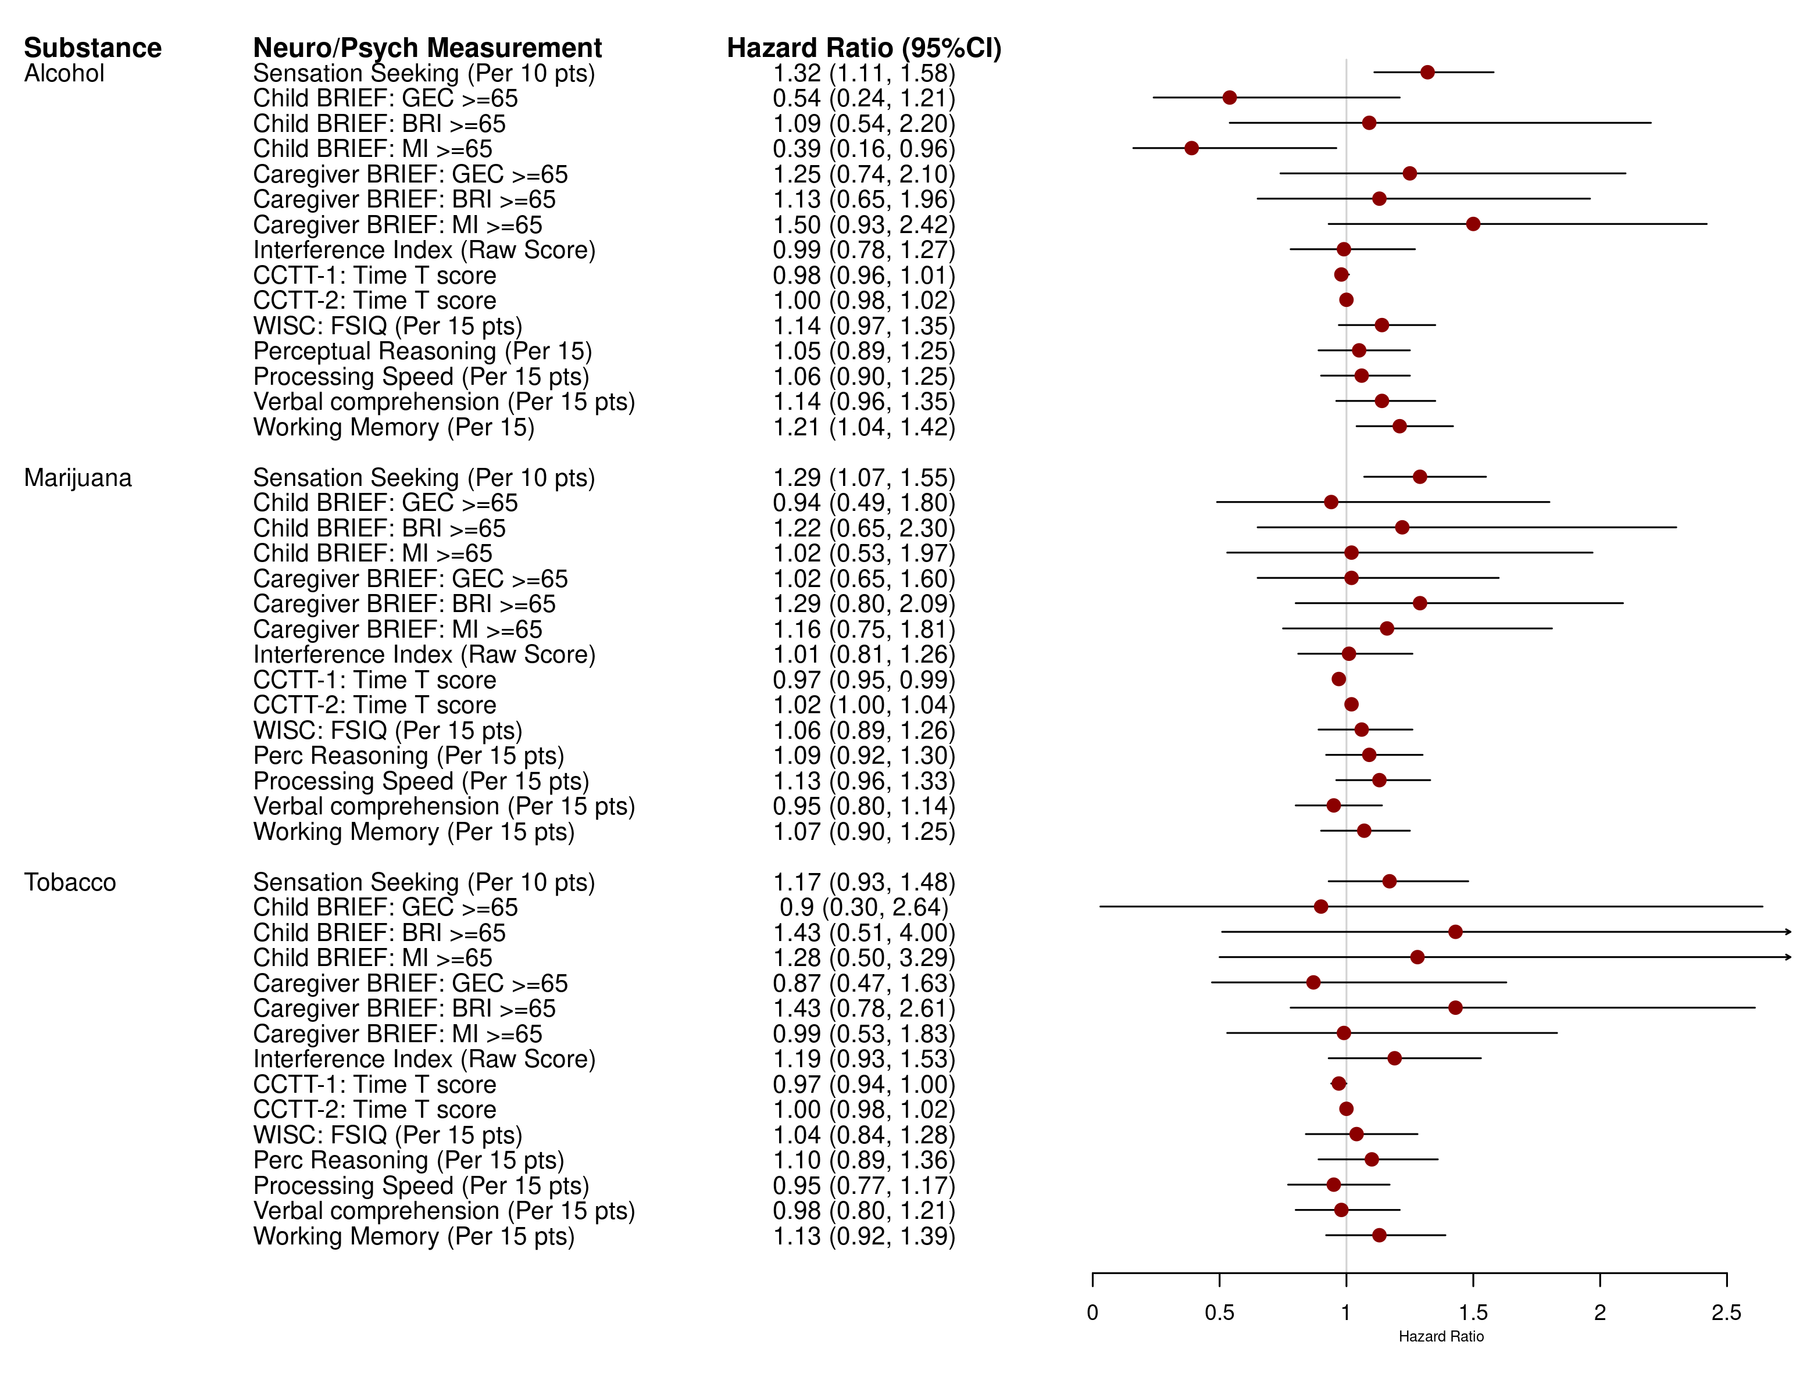


PEB0320
The Role of Behavioral and Neurocognitive Functioning in Substance Use among Youth with Perinatally Acquired HIV Infection and Perinatal HIV Exposure without Infection
S. Nichols¹, S. Brummel², K. Malee³, C. A. Mellins⁴, A.-B. Moscicki⁵, R. Smith⁶, A. Cuadra⁷, K. Bryant⁸, C. Boyce⁸, K. Tassiopoulos², for the Pediatric HIV/AIDS Cohort Study
¹University of California, San Diego, La Jolla, United States, ²Harvard T.H. Chan School of Public Health, Boston, United States, ³Northwestern University Feinberg School of Medicine, Chicago, United States, ⁴HIV Center for Clinical and Behavioral Studies, Columbia University, New York, United States, ⁵David Geffen School of Medicine, University of California Los Angeles, Los Angeles, United States, ⁶University of Illinois at Chicago, Chicago, United States, ⁷University of Miami Miller School of Medicine, Miami, United States, ⁸National Institutes of Health, Bethesda, United States
BACKGROUND
RESULTS
Substance use (SU) is common among adolescents and may contribute to poor health outcomes among youth with perinatally acquired HIV (YPHIV). Identifying cognitive and behavioral predictors of SU may inform interventions to prevent problems associated with SU among YPHIV. We examined associations of SU with cognitive and behavioral measures among YPHIV and youth with perinatal HIV exposure without infection (YPHEU), focusing on self-regulation which has been associated with SU initiation in the general population.
Table 1. Characteristics of Participants and their Caregivers
Figure 1. Association of Behavioral and Cognitive Measures with Prevalent Use
Main Results
About half of participants reported ever using alcohol or marijuana by the end of the study; of those, many reported concerning use patterns (Table 3).
Higher sensation-seeking, worse self-reported self-regulation and lower everyday executive functioning were associated with both incident and prevalent use of alcohol and marijuana for both groups, and with prevalent use of tobacco. Self-report showed stronger relationships than caregiver report.
Better cognitive functioning was associated with higher likelihood of incident and prevalent alcohol or marijuana use, particularly perceptual reasoning with prevalent alcohol use.
Few interactions between predictors and HIV status were seen.
METHODS
Study Population and Measures
Participants: YPHIV and YPHEU aged 7-15 years at 15 urban Pediatric HIV/AIDS Cohort Study Adolescent Master Protocol sites in the U.S., followed for ≤ 7 years with repeated assessments.
Measures - Participants Only: Executive functioning: Color Trails test (CCTT); I.Q. and cognitive domains: age-appropriate Wechsler test (WISC-IV, WAIS-IV); SU: self-report of alcohol, marijuana, tobacco and other substances via confidential audio computer-assisted self-interview (age 10+), including ever used, how often over prior 3 months, and consequences for daily functioning.
Measures - Participants and Caregivers: Self-regulation: Behavior Assessment System for Children-2 (BASC-2) Sensation Seeking scale. Executive functioning: Behavior Rating Inventory of Executive Functioning (BRIEF) General Executive Composite, GEC; Behavioral Regulation Index, BRI; Metacognitive Index, MI.
CONCLUSIONS
Table 2. Substance Use Frequency (Worst Ever Report)
Worse self-regulation predicts alcohol and marijuana use regardless of HIV status. This suggests that substance use screening tools and self-regulation-based interventions developed for the general adolescent population could be effective for YPHIV and YPHEU. Measuring self-regulation should prioritize youth self-report.
Higher cognitive performance was associated with greater likelihood of prior substance use, indicating earlier use, among adolescents affected by PHIV and warrants further follow-up.
The difference in SU associations with behavioral self-regulation and cognitive measures may have intervention implications and bears additional study.
Figure 2. Association of Behavioral and Cognitive Predictors with Incident Risk
Statistical Methods
All time points with SU assessments were included.
Models were adjusted for caregiver type, sex, Hispanic ethnicity, race, and age
Two sets of models were constructed:
  Prevalence analyses included the entire sample. Generalized estimating equations with a logistic link examined associations of cognitive and behavioral predictors with self-report of SU before the baseline visit.
  Incidence analyses for each substance excluded participants who reported using the substance prior to baseline. Cox survival models examined predictors of incident use of the substance while on study.
ACKNOWLEDGMENTS
Table 3. Substance Use Consequences¹
Thanks to the youth and caregivers who participated in our study.
Funded by the National Institutes of Health, under cooperative agreements HD052104 (PHACS Coordinating Center, Tulane University School of Medicine) and HD052102 (PHACS Data and Operations Center, Harvard T. H. Chan School of Public Health). We thank the study participants, clinical sites, PHACS CAB, Frontier Science & Technology Research Foundation, and Westat.
¹Among all youth who responded at least once.
PRESENTED AT THE 23RD INTERNATIONAL AIDS CONFERENCE (AIDS 2020) | 6-10 JULY 2020

